Slide 1
COURSE PLANNING Grade 8 into 9
WELCOME !
Graduation Program
Grade 9 Program

Slide 2
COUNSELLORS
Grades 8 - 9
A. Rice
Grades 10 - 12
C. Walton A-M
S. McAllen N-Z
Notes:
‹#›

Slide 3
GRADUATION REQUIREMENTS
Credits assigned to courses in grade 10 - 12
Courses vs Credits
One full course = 4 credits
80 credit minimum for graduation
**This has not changed**

Slide 4
GRADUATION REQUIREMENTS
To Graduate:
52 required credits
+ 28 elective credits
= 80 Credits for graduation
** Minimum of 16 credits at the Grade 12 level

Slide 5
GRADUATION REQUIREMENTS
Required Credits:
English 10, 11, and 12
Socials Studies 10, 11 or 12
Science 10, 11 or 12
Math 10, 11 or 12
Physical Health and Education 10
Career Life Education (CLE 10)
Career Life Connections (CLC 12)
Fine Arts or Applied Skills
Indigenous Content Course (currently incorporated in Language Arts)
Notes:
‹#›

Slide 6
GRADUATION REQUIREMENTS
Replacements for the previously written provincial exams.
Numeracy exam – written in gr. 10 (since 2017/2018)
Literacy exam – written in gr. 10 and 12 (since 2018/2019)
Information and samples on the Ministry Website. Search online under:
“Grade 10 BC Numeracy and Literacy Assessment”
“Grade 12 BC Literacy Assessment”
Notes:
Passes all 5 exams, gets a B or better in the Language Arts 12 exam and is one of the top 5000 marks in the 5 exams ($1000) – top twenty students will receive $2500
‹#›

Slide 7
GRADE 9 COURSES
1. English 9 (Eng 9 “TR” or Eng 9 “LA”)
2. Social Studies 9 (SS 9 “TR” OR SS9 “LA”)
3. Math 9, Math 9 Enriched, Math 9 Foundations
4. Science 9 (Sc 9 “TR”)
5. Physical Education 9
6. Language 9 or English Language Development (ELD) or another Elective
7. Fine Arts Elective
8. Applied Skills Elective
9. ‘Outside the Timetable’ courses –
Concert Choir AM, Band AM, Orchestra AM (by audition),
*(ELL classes)

Slide 8
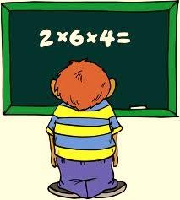
GRADE 9 MATH COURSES
Math 9
Enriched Math 9 (by recommendation only)
Math 9 foundations

Slide 9
ELECTIVES
LANGUAGES
French 9
Japanese 9*
Mandarin 9*
Spanish 9*
Students do not need a language to graduate.
* Beginner Level Course

Slide 10
ELECTIVES
APPLIED SKILLS COURSES
(ADST = applied design skills technology
Computer Studies 9: Media Design
Computer Studies 9: Computer Science
Metalwork 9
Woodwork 9
Food & Nutrition 9
Drafting & Design 9*
Textile Studies 9*
*could also satisfy Fine Art requirement

Slide 11
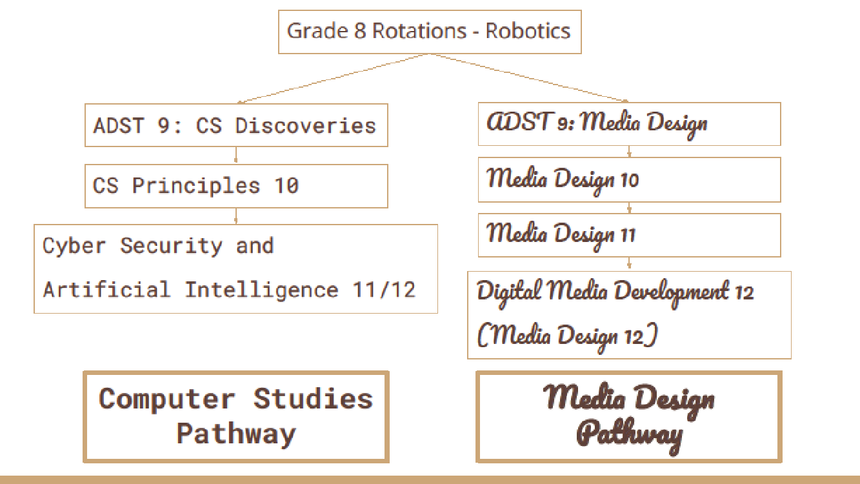

Slide 12
ELECTIVES
FINE ARTS COURSES
Visual Art
Art 9
Photography 9
Media: Animation & Video 9
Music
Guitar (Intro and Advanced classes)
Rock Band 9 (experience required)
Jazz Band 9 (experience required)
Theatre Arts:
Dance 9, Dance Crew **
Drama Foundations 9
Directing and Scriptwriting 9
**audition required

Slide 13
District Programs
Premier District Academies
Sports: Badminton, Baseball, Basektball, fencing, field hockey, Rugby, Soccer, Tennis, Volleyball.
Robotics: Mechatronics Robotics
Premier District Programs
F.A.S.T. (First Aid Swim Training)
Outdoor Recreation (gr 10-12 open to 9’s)
200 Hour Yoga Teacher Training (gr.9-12)
IB Diploma
Gr. 10 PDP (pre diploma program) courses
(register when course planning for gr. 10)
Notes:
Bball Academy – info night April 8 and tryouts April 29/30
Super Achievers – high level athlete (usually provincial level or higher – 20 direct hours of training per week)
FAST – apply online: grade 9 and above
District Academies – see district website
YELL – grades 11/12 (business/entrepreneurship opportunities)
ACE-IT – grade 11/12
Culinary Arts – grade 11/12
‹#›

Slide 14
EXTERNAL COURSES
Learning outside of the school
Approved, authorized by ministry
Credits given upon successful completion of these learning activities developed and/or offered outside of the BC school system
**keep these certificates/letters and show to counsellor in grade 10

Slide 15
EXTERNAL COURSES
Music ex) RCM
Dance ex) Royal Academy of Dance
Language
Drama/speech/communication ex) RCM Drama
Sports ex) Provincial/National Level
Youth Development ex) Girl Guides or Cadets
Industrial and Occupational ex) Drivers Ed, NLS, Ski/Snowboard Level 1

Slide 16
Communicating with Students
I will be presenting to all grade 8 English classes beginning Feb 5th.
Students will receive a course planning sheet that must be filled out:
- choices get uploaded to myed
- pencil/paper sheets are to be submitted to Mrs. Krieger or Amy Rice

Slide 17
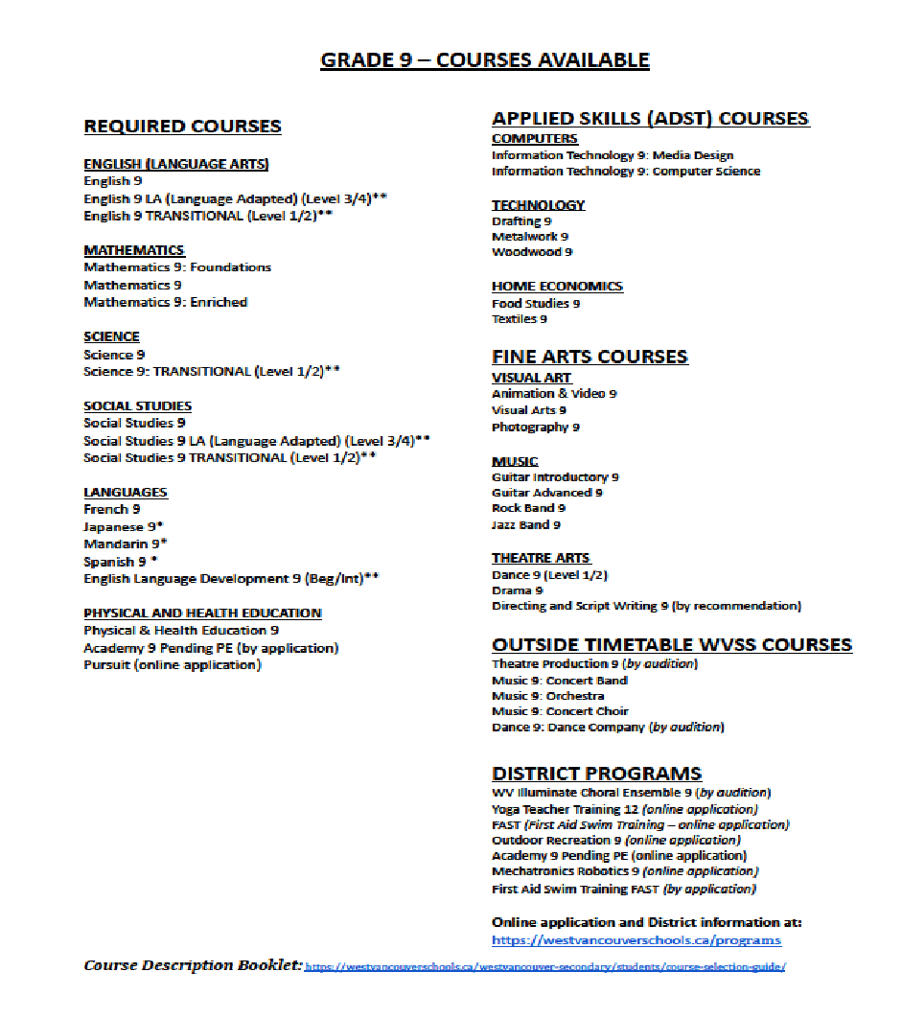
Grade 9 Course Planning Sheet

Slide 18
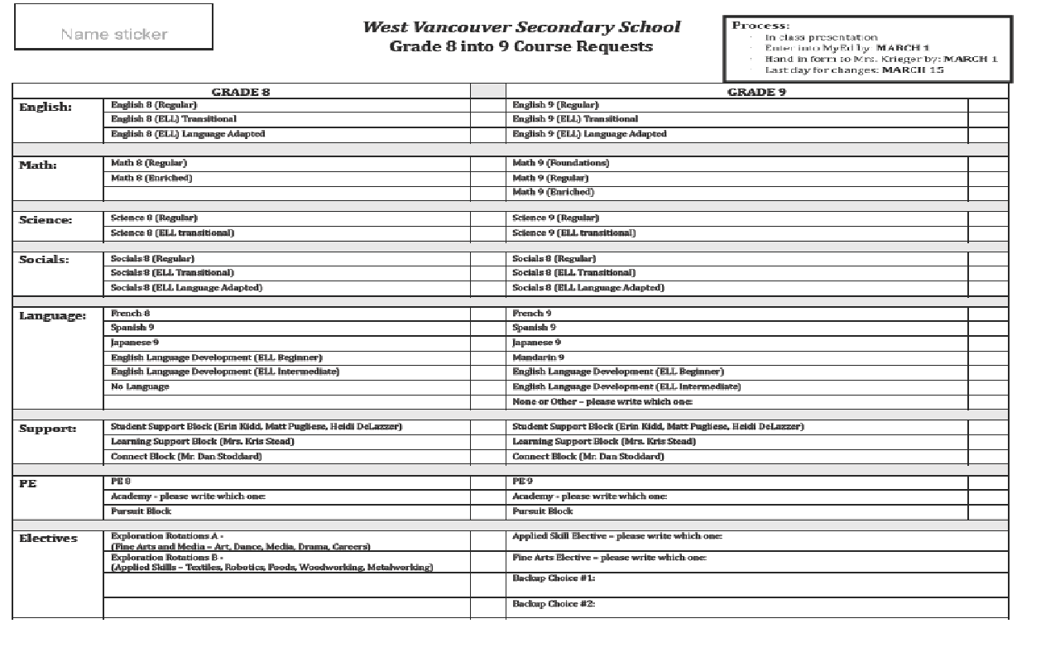
Grade 9 – Course Requests

Slide 19
Course Description Booklet:
Check counselling website

Slide 20
QUESTIONS ? arice@wvschools.ca 604-981-1327 Course Booklet and Power Point at: http://go45.sd45.bc.ca/schools/westvancouver/students/Pages/Counselling.aspx

