Slide 1
West Bay Elementary
Capstone Presentation
June 1, 2017

Slide 2
Mission Statement
In an atmosphere of mutual respect West Bay inspires, encourages and challenges students to become active, compassionate lifelong learners within their local and global communities.
“…school communities that are rudderless and aimless cannot fully prepare their children for the new, fast-changing realities of the modern world.” (Richardson and Dixon, 2017)

Slide 3
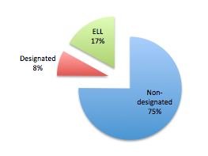
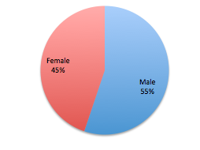
School Context
Who We Are
Total Students 406 (224 Males & 182 Females)
93% of our population resides in West Vancouver
(Enrollment Report, November 21, 2016)

Slide 4
Unique Features
International Baccalaureate Primary Years Programme
(IB PYP)
Authorized in 2007 (Evaluations in 2010 and 2015)
Second language instruction K through Grade 7
Language choice Grade 7 (French, Spanish)
Transdisciplinary approach
Exhibition - culminating project at the completion of the PYP experience

Slide 5
Framework for Enhancing Student Learning
Where have we been and where are we going?
What are our ‘challenges’ and ‘strengths’ for our learners?
Keeping the end in mind….
Improving the learning environment for all learners

Slide 6
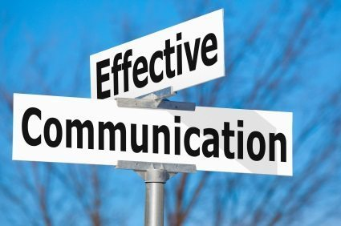
School Goal
For three years, our goal has been…
“To improve students’ communication competency”
“The communication competency encompasses the set of abilities that students use to impart and exchange information, experiences and ideas, to explore the world around them, and to understand and effectively engage in the use of digital media.” Ministry of Education

Slide 7
What should teaching and learning look like?

Slide 8
Staff and Parent Involvement
Year | Staff | Parents
2014-15 | Scan learners (Fall) Review data (Spring) Scan learners (Spring) Determine direction | SPC Meetings 4 times/year PAC Meetings
2015-16 | Scan learners (Fall) Review data (Spring) Scan learners (Spring) Determine direction | SPC Meetings 4 times/year PAC Meetings
2016-17 | Scan learners (Feb) Review data/Teacher Reflections (Spring) Shift direction | Feb. PAC Meeting April PAC Meeting June PAC Meeting

Slide 9
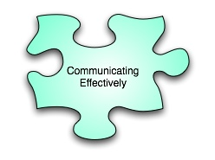
Four Facets of the Communication Competency
Connect and engage with others (to share and develop ideas) Year 1, 2, 3
Acquire, interpret, and present information (includes inquiries) Year 1
Collaborate to plan, carry out, and review constructions and activities
Explain/recount and reflect on experiences and accomplishments Year 2, 3

Slide 10
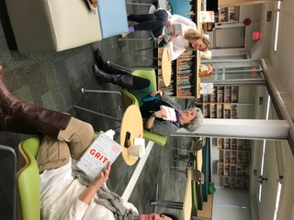
New Learning
FreshGrade Workshops
Essential Agreement
Adrienne Gear Reading and Writing Power
Staff Book Club – learning with one another
Technology Tools – learning from teacher-leaders

Slide 11
Spotlight on Strategies

Slide 12
Strategies – Facet One
Connect and engage with others (to share and develop ideas)
Living Library
Passion to Action Projects
Technology – Mystery-Skype; Quest mentors
Inter-generational Projects
Spanish – Language 7 Choice
Drama Workshops
Buddy Classes

Slide 13
Spotlight on Strategies

Slide 14
Strategies – Facet Two
Acquire, interpret and present information (includes inquiries)
Exhibition
Ignite West Bay!
Providing choice for presenting learning
Class presentations

Slide 15
Spotlight on Strategies

Slide 16
Strategies – Facet Four
Explain/recount and reflect on experiences and accomplishments
FreshGrade (IB Articulations and Reflections)
Journal Entries / Letter Writing
Video reflections (Grade 7 Exhibition)

Slide 17
What is the Data Telling Us?
Cold Writes
FSA (Gr. 4 and 7 Writing)
Communications Survey to all students
Passion Projects (2016) Grade 6 Feedback
Grade 8, 9 Communication Skills Survey
Language 7 Survey
Teacher Reflections

Slide 18
Cold Write Data (% fully meeting or exceeding)
Grade | Fall | Spring
1 | 17% | 68%
2 | 32% | 64%
3 | 19% | 56%
4 | 29% | 78%
5 | 44% | 91%
6 | 39% | 68%
7 | 89% | 82%

Slide 19
Cold Write Data
Expected improvements occurred; movement towards meeting and exceeding; however we only met target at two grade levels.
Highlights:
Grade 4 Fall 55% Minimally Meeting Spring 65% Fully Meeting
Grade 1 Fall 48% Not Yet Within Spring 51% Fully Meeting
Areas requiring our attention:
Grade 2 “style” and “form”
Grade 7 “conventions”

Slide 20
FSAs – Grade 4 (by gender)
GIRLS | Not Yet | Meeting | Exceeding
Reading | 0 | 8 (31%) | 18 (69%)
Writing | 0 | 16 (62%) | 10 (38%)
Numeracy | 0 | 6 (23%) | 20 (77%)
BOYS | Not Yet | Meeting | Exceeding
Reading | 0 | 14 (45%) | 17 (55%)
Writing | 0 | 21 (68%) | 10 (32%)
Numeracy | 0 | 4 (13%) | 27 (87%)

Slide 21
FSAs – Grade 7 (by gender)
Girls | Not Yet | Meeting | Exceeding
Reading | 0 | 10 (37%) | 17 (63%)
Writing | 0 | 18 (67%) | 9 (33%)
Numeracy | 0 | 12 (46%) | 14 (54%)
Boys | Not Yet | Meeting | Exceeding
Reading | 0 | 21 (68%) | 10 (32%)
Writing | 0 | 27 (87%) | 4 (13%)
Numeracy | 0 | 13 (42%) | 18 (58%)

Slide 22
FSA Data Analysis
Grade 4
Girls tend to score better in Reading
Results indicate strong Numeracy skills overall for both girls and boys (although boys perform slightly better)
Writing - All 37 students in the ‘meeting’ category (6-9) received a ‘9’
Grade 7
Minimal gender discrepancy except in Reading where girls outperform boys
Writing - All students in the ‘meeting’ category (6-9) scored a ‘9’ except 1 ELL student who scored ‘8’

Slide 23
Communications Survey (Primary)

Slide 24
Communications Survey (Primary)

Slide 25
Communications Survey (Primary)

Slide 26
Communications Survey (Primary)

Slide 27
Communications Survey (Intermediate)

Slide 28
Communications Survey (Intermediate)

Slide 29
Communications Survey (Intermediate)

Slide 30
Communications Survey (Intermediate)

Slide 31
Communications Survey (Intermediate)

Slide 32
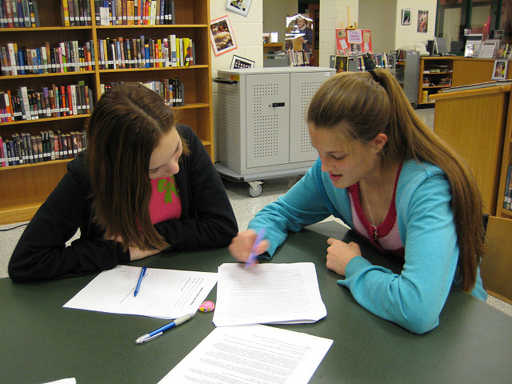
Intermediate Students’ Written Feedback
Strategies that improved your presentation skills:
“Practising your presentation over and over. Getting a peer to edit your work and tell you what would be better for your
presentation.”
“Adding many visuals such as pictures, videos, etc. to slides to replace words presented verbally in your presentation helps engage the audience and gain their attention.”
“I usually just practice the things I am going to say over and over again. That way, it's quite hard to make a mistake. It's also very nice knowing that a lot of my peers are very non-judgmental.”
Notes:
Data was collected from 144 of the 180 students from grade 5 to grade 7; students completed the survey through an online Google Form and could add comments at the end

Slide 33
Intermediate Students’ Written Feedback
“There are multiple strategies that have allowed me to improve my presentation skills. First of all, being taught about breathing before a presentation. It helps you calm down, therefore delivering a clear speech. Also being given the chance to present to the community helps. The Passion Project, Ignite, and Ceremonies. Presenting in front of adults, or other important people builds up confidence. I feel like the accessibility to technology or cue cards has also helped me present as well as I can.”
Notes:
Data was collected from 144 of the 180 students from grade 5 to grade 7; students completed the survey through an online Google Form and could add comments at the end

Slide 34
Passion to Action Feedback
56% agree or strongly agree that blogging and emailing mentors improved their written communication skills
59% agree or strongly agree that their verbal communication skills improved when interacting face to face with mentors
69% agree or strongly agree that they were able to visually communicate their passion with their website and presentation

Slide 35
Communication Survey (Gr. 8, 9 students)
Data Highlights:
(% of students indicating ‘quite a lot’/‘very much so’)
91% indicated that experiences at West Bay helped improve their communication skills
100% indicated that they feel confident when presenting to classmates or a large group
100% indicated that their experiences at West Bay prepared them to communicate ideas through writing
67% indicated that interacting with experts/mentors face to face or via technology improved their communication skills
Notes:
35% return rate (12 students

Slide 36
Language Choice Survey

Slide 37
Language Choice Survey

Slide 38
Language Choice Survey

Slide 39
Teacher Reflections
Greater confidence in learners
Students eager to ‘connect and engage’, share, contribute
FreshGrade – effective way to develop students’ ability to ‘explain, recount and reflect’
Intermediate grades – greater emphasis on developing research skills where students ‘acquire, interpret and present’ their learning and thinking with others

Slide 40
Teacher Reflections
Independent/group inquiries foster communication skills
Various presentation modes taught (‘toolkit’ for students)
Culmination of inquiries showcased at Open Houses or Celebrations of Learning (wider audience)
Continued work needed on communicating thinking in writing

Slide 41
Parent Feedback
Reflections from PAC Chair Danielle Katerberg

Slide 42
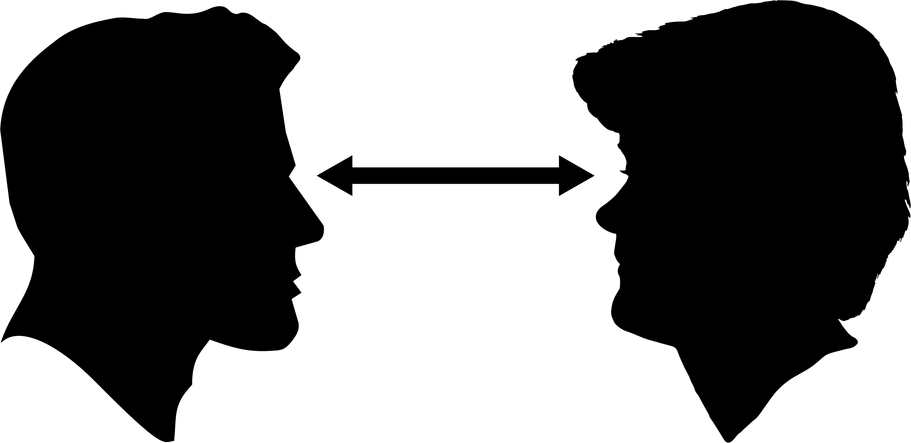
Parent Feedback
“I have received many comments from friends’ parents on both my daughters’ communication skills. The parents always comment on how my children will talk to them and look at them in the eye…My daughter is able to express herself and knows that she can ask questions and solve problems.”

Slide 43
Parent Feedback
“My three children have had the privilege of attending West Bay Elementary. One is now in high school studying for the IB Diploma, the others are in Grade 6 and 3 respectively. The communication skills students at West Bay are taught and given frequent opportunities to utilize, are superior in my opinion to those of many students in university and professionals in the workplace. When I recently watched my 6th grader present in front of an audience, using engaging PowerPoint slides she prepared, gesturing and walking in front of these with confidence, and speaking with knowledge and passion, I counted our lucky stars once again for a West Bay education!”

Slide 44
Parent Feedback
“In grade 6, during the passion project my son was encouraged to increase his comfort using email to communicate with teachers and members of the community. During this process he sent numerous emails requesting dates and times… additional emails clarifying his intentions, and follow up emails thanking people for their participation. Initially, he asked and (from my perspective!) needed support, however, by the end he was confident in his abilities (as was I!) and only asked me to read the emails ‘in case I missed something’ …”

Slide 45
Parent Feedback
“This year, we have seen a dramatic improvement in his connection to his writing and recognize that he now requires more time to complete assignments. He spends a great deal of time reflecting and using the thesaurus to find the 'exact word' to convey his message and meaning. This meaningful intention in his learning is exactly what we, as his parents, had hoped for when we enrolled him at West Bay!”
“…we wish to especially acknowledge the time, energy, and effort that has gone into establishing and implementing the clear and effective communication strategies that occur daily at West Bay.”

Slide 46
Parent Feedback
“We have been so pleased with the development of our daughter’s communication over the last few years. She was quite shy and self-conscious about sharing her thoughts and feelings in the past. I believe West Bay has helped her find her voice in many ways. I have always been impressed with the encouragement in the classroom to take the risk of sharing ideas and questions, even half-cooked ones.”

Slide 47
Parent Feedback
“The opportunities to work collaboratively with peers and teachers (Exhibition being an example), opportunities for public speaking (Ignite speech and in-class presentations), opportunities to engage with the community of West Vancouver, opportunities to communicate with large groups in the form of music, dance and drama have all contributed to developing her communication competency. Thank you so much for all of this! Beyond all the facts and figures in education, I think communication skills are key to all future endeavours.”

Slide 48
Parent Feedback
“Our daughter has benefited from West Bay’s recent focus on developing communication competency. We have found that classroom strategies of group activities, presentation skills, and an emphasis on concrete action has created a fertile educational environment in which she is fully engaged and is flourishing.
The lessons learned from group activities such as shared responsibilities, team work and cooperation, when combined with the diverse presentation skills, be they conventional PowerPoint style, public speaking or just fun skits, builds creative, confident and collaborative learners.”

Slide 49
Parent Feedback
“…As for my daughter, I am truly speechless. She has developed an uncanny ability to critically analyze any subject she is presenting on and articulate her thesis in a logical and persuasive way that is nothing short of impressive. I can tell you unequivocally that she can put many of my university students to shame when it comes to presenting, writing and getting her point across. I certainly was not as advanced at her stage.”

Slide 50
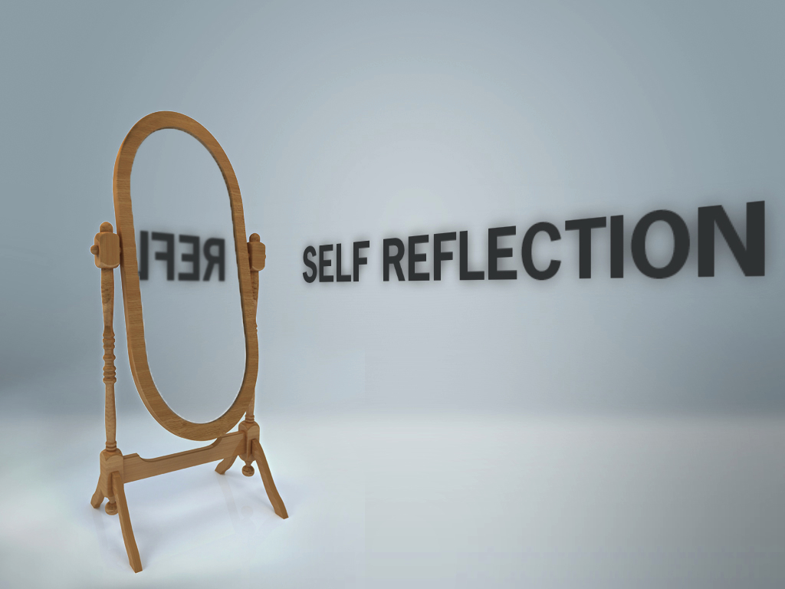
Summary
Data is telling us:
We are developing confident communicators who are keen to connect with others using technology and face-to-face interactions
Students are able to use a variety of tools when presenting to small and large groups
We need to continue working on developing students’ writing skills
Further work is warranted on developing students’ ability to reflect on their learning

Slide 51
Where to Next?

Slide 52
Scanning Our Learners (2016-2017)
Strengths | Challenges
Creativity Communication Skills - oral language (primary) - writing - debating - presenting Digitally capable Helpful, inclusive, empathetic | Critical thinking Listening (Primary) Self-regulation (Primary) Problem-solving (social, math) Accountable for own learning Personal responsibility

Slide 53
In the next 10-20 years…
“Youth will need to be equipped with a broad suite of technical and soft skills. …The value of creativity, problem-solving and social intelligence – skills that remain difficult for technology to replicate – is also expected to grow.”
(Brookfield Institute, “Future-Proof: Executive Summary”, 2017)

Slide 54
Focusing
Core Competencies:
Personal and Social
Communication
Thinking (Critical and Creative)
Critical Thinking is a logical extension of our work done in the area of communication
Analyze and critique
Question and investigate
Develop and design
Notes:
TrInterconnected nature of the competenciesanscend all curricular areas

Slide 55
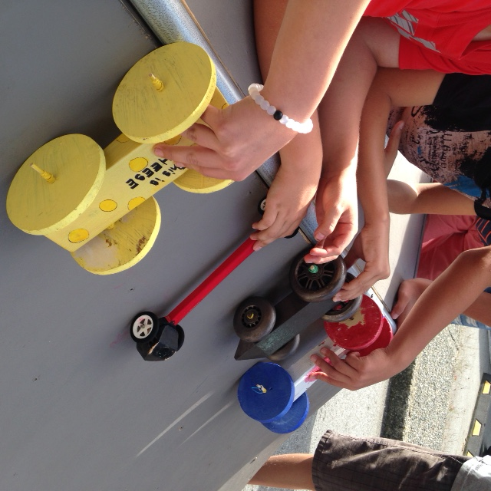
Professional Learning
Staff Book Club (e.g., Creating Thinking Classrooms, by Roland Case)
Parent Book Club (e.g., Mind in the Making by Ellen Galinsky)
Critical Thinking Consortium (TC2); Purchase TC2 books
Brain Science – examine thinking
Design Process (ADST)
Maker Lab (October, 2017)
Critical Thinking Assessment Tools
Executive Functioning (WV Schools, Sarah Ward)
Adrienne Gear – Metacognition

Slide 56
Connections to District Pillars
Inquiry
Asking questions to verify
Formulating a vital problem, question or issue
Self-Regulation
Executive functioning - cognitive domain
Developing responsible, independent learners who can problem-solve
Digital Access
Analyzing reliability of digital sources
Developing and designing using technology

Slide 57
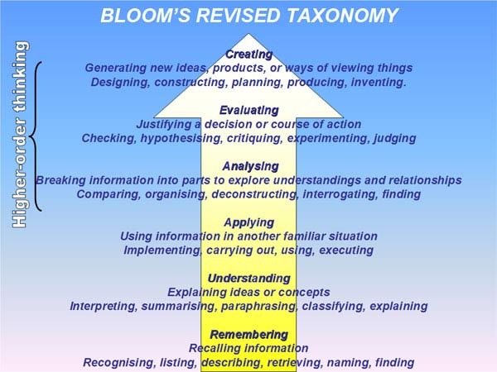
Connections to Principles of Learning
Learners at the centre
“Critical thinking is self-directed, self-disciplined, self-monitored and self-corrective thinking.” (Paul and Elder, 2006)
In the modern world, being a self-directed and self-determined learner is the most important skill to develop. (Richardson and Dixon, 2017)
Social nature of learning
In order to think critically, students must be able to look at different viewpoints and interact effectively
Stretching all students
All students can benefit from developing
higher order thinking skills, including
analyzing, evaluating and creating

Slide 58
Connections to First Peoples Principles of Learning
Learning ultimately supports the well-being of the self, the family, the community, the land, the spirits, and the ancestors.
Learning involves recognizing the consequences of one’s actions.
Learning is holistic, reflexive, reflective, experiential, and relational (focused on connectedness, on reciprocal relationships, and a sense of place).
Learning involves patience and time.

Slide 59
Thank you
Thank you for the opportunity to share our learning
Thank you for supporting our teachers and learners
Innovation Grants have allowed us to push our students’
thinking (and our own)
Attending events, interacting with students, being responsive
We are excited about the growth in our learners
We are excited with our new direction
While developing critical thinkers, we will continue to ensure ‘joy’ is infused in teaching and learning

Slide 60
In Closing…
“Do you know where you're going to? Do you like the things that life is showing you? Where are you going to, do you know? Do you get what you're hoping for? When you look behind you there's no open door. What are you hoping for, do you know?” (Masser & Goffin)
It’s our job to arm our students with the skills and competencies they need to help them navigate their world.

