Slide 1
DPAC Superintendent Update
February 3, 2021

Slide 2
Enrolment
Total applications received between October 15th and January 22nd
  2021-22 743
  2020-21 666
Total applications received between January 15th and 22nd
  2021-22 219
  2020-21 153
Out of district applications received between October 15th and January 22nd
  2021-22 199
  2020-21 166
Out of district applications received between October 15th and January 22nd
  North Van 132 (+14), Sea to Sky 10 (+3), Vancouver 41 (+19), Staff 8 (+2)

Slide 3
Budget Planning for 2021-22
2021-22 budget feedback is ongoing and an opportunity for input
Biggest unknown for 2021-22 is the size of the “bounce back” of international students
Potential for a delay of the 2021-22 budget to June because of the change to the timing of the Provincial budget

Slide 4
Schedule Planning for 2021-22
Planning for full-time in-person elementary and secondary school
Secondary – starting from quarter system with the opportunity to scale up to other models
Secondary Student, Staff and Parent surveys went out on February 1st

Slide 5
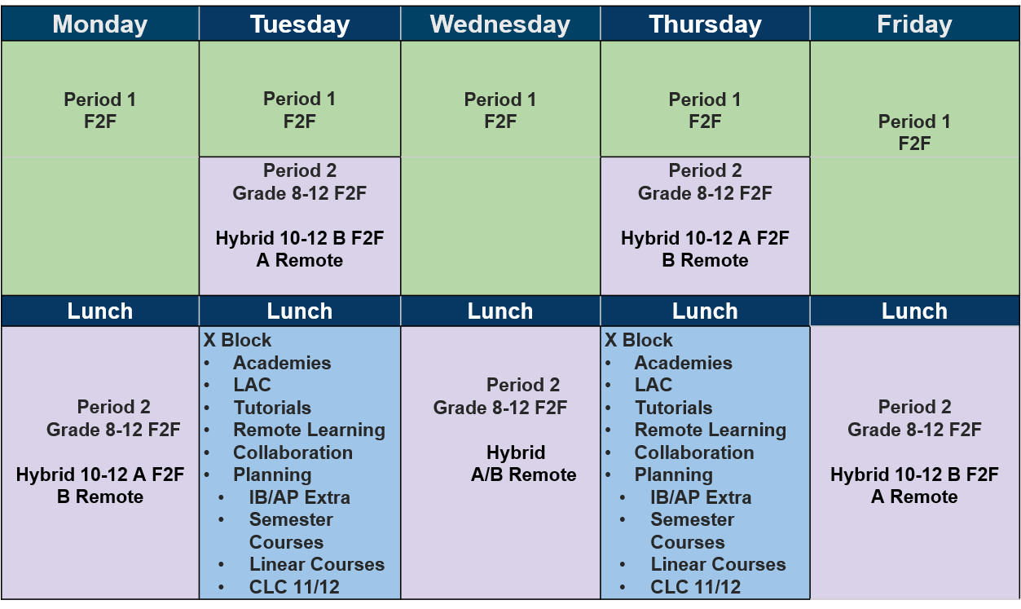
Secondary Program for 2020-21

Slide 6
Secondary Program High Level Feedback
Quarter System
Top 5 Likes - Ranked
Improved focus
Less homework and more manageable workload
Work is more efficient and organized
Improved quality of learning
Improved interactions and relationships with teachers
Top 3 Dislikes - Ranked
Less engagement (repetitive instructional strategies and long classes)
Fast paced/rushed/intense
Lack of breaks and long classes
Feedback is very diverse and varied
Overall positive feeling
Quarter System is working
Google Classroom is beneficial for organization and communication
Hybrid is more challenging than face to face
X Block has been well received and continues to evolve

Slide 7
Temporary Transition Program (TTP) and Youth Worker Support
Next return date is XXXX
There will also be a return date on March 29th
Announcement on post-spring break period by February 19th
Currently 1 cohort of high school students and about XXX elementary students in the TTP Program
COVID Outreach Youth Worker has been an extra layer of support
So far we have had 64 referrals to the worker
Minimal concerns from parents during isolation – strong teacher connections

Slide 8
7 Things That Will Stick
Nationalized conversation of education
Essential use of new communication tools
High schools are changed forever
Health and Education are permanent partners
Digitization
Equity
Learning Outside

