Slide 1
Rockridge PAC Meeting
February 28th, 2018

Slide 2
Thank you…
Rockridge parents for supporting student learning by:
Funding wish list items
Organizing our upcoming Non-Winter Party (special thanks to Linda and Darius for all their work)
Providing food for our International Luncheon
Coaching our teams

Slide 3
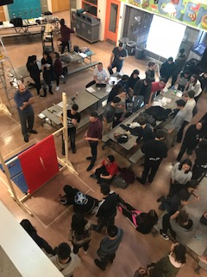
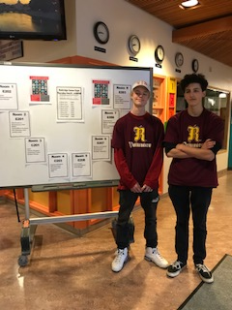
Student Learning
Physics Olympics
Career Expo

Slide 4
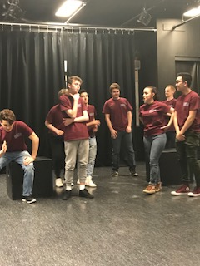
Student Learning
Rockridge Theatre Company
Improv Team

Slide 5
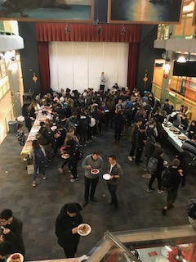
Student Learning
Clubs
Kanata Club
We Club
Model UN
Interact Club

Slide 6
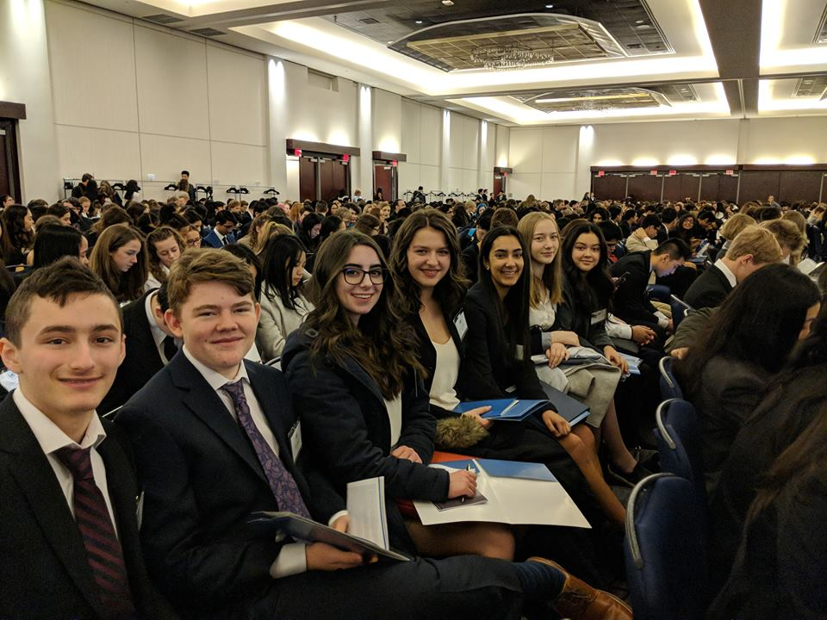
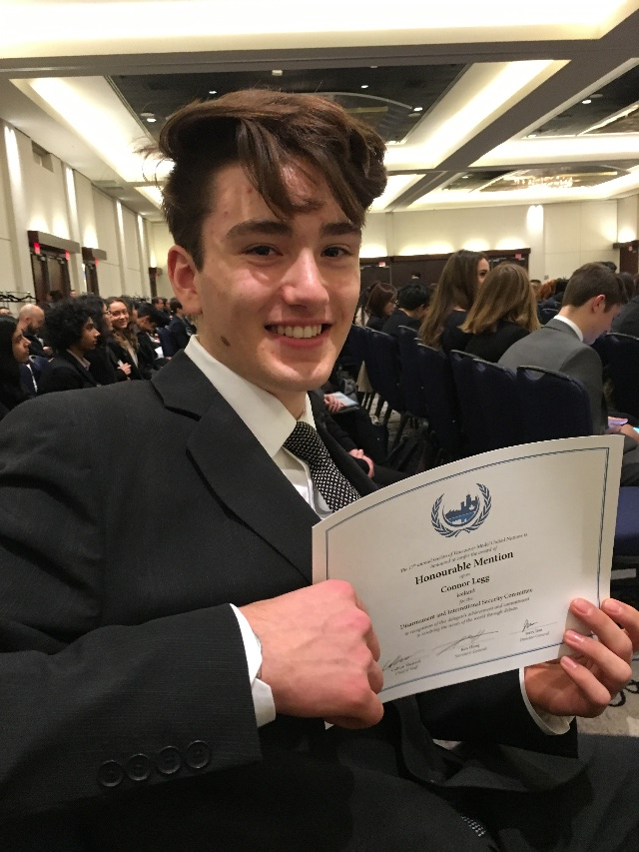
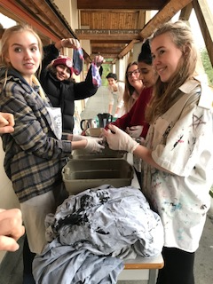

Slide 7
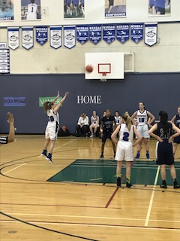
Athletics

Slide 8
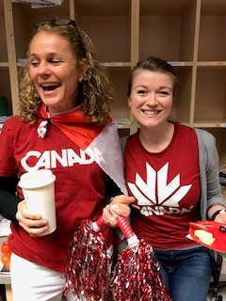
School Spirit

Slide 9
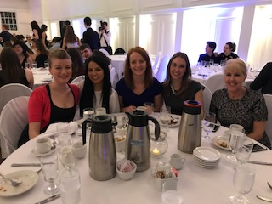
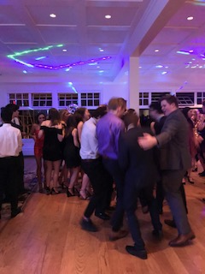
Grad Semi-Formal

Slide 10
What’s Next?
Rock Talks
For Grades 8, 9, 11, 12
Grade Rounds in Players Hall - March 6th
School Round in Gym – March 9th

Slide 11
Grade 10 MYP Personal Projects

Slide 12
“Grey Matter”
Mr. Shannon’s Advanced Film class
Kay Meek Theatre on March 15th
6:00pm and 8:00pm

Slide 13
Health Conference
Mental Health Conference for Grade 9s
“Be Kind to Your Mind”
April 5th and 12th (Collaboration Days) mornings only
Stephanie Jansen organizing
PE Department delivering
Counsellors supporting
Sue Foster guiding

Slide 14
Framework for Enhancing Student Learning
Year 2
An update on progress towards inquiry questions/foci is shared with FOSL in May
Year 3
A Capstone Presentation and short, summative report to district colleagues by June 30th
Year 1
Schools work with their communities to create a plan by July 15th of Year 3 in the cycle

Slide 15
Year 2
Inquiry
Improve organizational, affective and reflective skills as per the IB MYP Self-Management Approach to Learning through engagement of students, staff, and parents.

Slide 16
Approaches to Learning (ATLs)
Communication
Social (collaboration skills)
Self-Management (organization, affective, reflection skills)
Research (information literacy; media literacy skills)
Thinking (critical, creative, transfer)
Alignment with BC Curriculum and the Core Competencies (Social/Personal)

Slide 17
Organizational Skills
How can students demonstrate organizational skills?
Managing time and tasks effectively:
Planning short and long-term
assignments
Meeting deadlines
Setting goals
Planning strategies and taking action to achieve goals

Slide 18
Affective Skills
How can students manage their own state of mind?
Mindfulness
Perseverance
Emotional Management
Self-Motivation
Resilience

Slide 19
Reflection Skills
How can students be reflective?
(Re)considering the process of learning; choosing and using Approaches to Learning skills:
Develop new skills, techniques and strategies
Identify strengths and weaknesses of personal learning strategies

Slide 20
What are our hunches?
School-related factors related to students’ lack of organization & affective skills?
Skills not being explicitly taught?
Students not using skills?
Too much work assigned?

Slide 21
Taking Action
Share best practices for developing effective organizational skills (teacher sharing in grade groups at staff meeting; student feedback)
Identify why students are not using skills (student surveys and interviews)
Reduce amount of work assigned
(PAC questionnaire; counsellors’ feedback)

Slide 22
Taking Action
What are we doing?
Created student-friendly rubrics for teacher and student self-assessments
Presentations to parents and students
Base Camp
Explore scheduling options

Slide 23
Flex Time
What is it?
An idea being explored
Adjustment to the length of each of the 4 blocks by 8,9 minutes
Use 33 minutes gained to provide “Flex Time”
Flex time would occur between 1st and 2nd block each day
Students choose class/area to attend

Slide 24
Flex Time
What could students do?
Use time to collaborate – group projects
Seek extra help from teacher
Complete a lab or project
Write a test they missed
Go to gym for a body break
Meet with a counsellor

Slide 25
Flex Time
Why change?
BC Ed Plan – flexibility and choice
Support development of students’ self-management skills (school goal)
Help mitigate students’ stress levels
Increase students’ access to teachers
Provide time for students to collaborate with one another

