Slide 1
What’s New + Exciting For Families at the Library
February 3, 2021
Shannon Ozirny, Head of Youth Services
sozirny@westvanlibrary.ca
Notes:
Please feel free to share this presentation far and wide!
Follow the links in the slides for more information.

Slide 2
Is the Library a Ghost Town? Are kids still reading?
Supporting WVS students: webpage + e-newsletter
2021 WVS/WVML partnership highlights
Virtual programs on reading practice, coding + design
Libby app: almost as good as Am*zon (I promise!)
New things to borrow!
Need a PAC speaker?

Slide 3
Big Changes in the Library
Seating or Study Space
In-Person Programs
Browsing
Holds Pick-Up
In-person help/reference
Phone, Email + Chat help/reference
Public Computers (90 minute sessions)
Staring February 15:
We will be open 7 days/week!
Open Family Day:
10am-5:30pm
Notes:
-If you’ve been inside the Library, you’ll notice it feels very different with no public seating or programs
-But we are actually circulating the same amount of physical materials per hour as we were before the pandemic; use of our digital materials (ebooks and e-audio) has greatly increased
-The strategy of sending one person from your household to get books and recommendations for everyone is a good one that most people have been using
-If you haven’t been yet, know that it’s not like the grocery store, where it’s unbearably busy at times: we have so much space, and such good safety measures and traffic flows in place that it is still a enjoyable place to come and browse or pick up items:
-TIP: the quietest times are in the mornings (9am-11am Weds + Sat, 10am-noon other days) and on Tuesday and Thursday evenings between 6-7:30pm

Slide 4
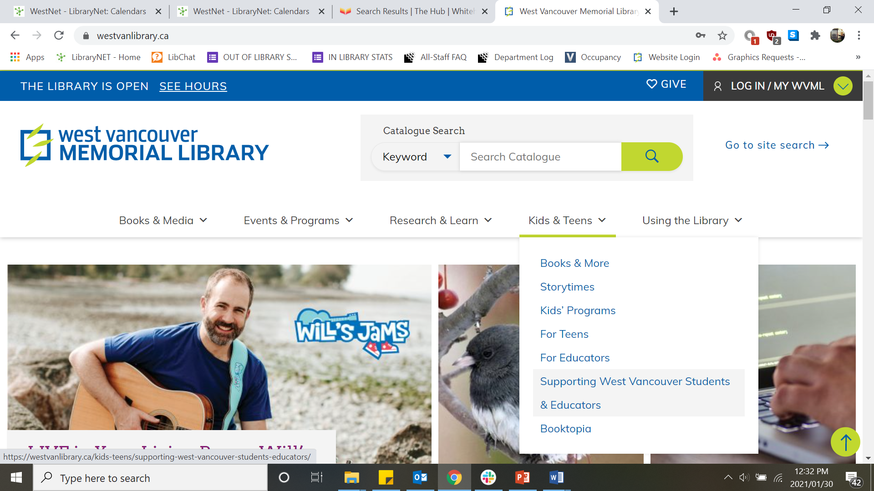
The One Library Page You Need: Find it Here
Notes:
-We’ve put everything that we think will be useful to teachers and families on one page, which you’ll find under Kids & Teens
-This page has information on:
-contacting the Youth Department for recommendations or ebook help
-getting a library card
-a list of the library’s best online resources for students of all ages including ebooks, e-audio, Solaro (self-study and quizzes by BC Curriculum subject for Grades 3+), Kanopy (streaming video) and more
-a list of programs we have coming up in the next week
-lists of unlimited ebook titles (no wait times) and recommendations by grade

Slide 5
How to Know What’s On at the Library
Subscribe to the monthly e-newsletter here
During the pandemic, we started a special newsletter for principals and teacher-librarians to share with families
(let Shannon know if your PAC wants it by email, too!):
Read and share the latest issue here
Notes:
-Subscribe to the e-newsletter for advance notice of programs for kids, teens and adults.
-Programs range from concerts, to author talks, to tech skills classes and more!
-All programs are free of charge and a library card is not required to register

Slide 6
WVS/WVML Partnership Highlights to June 2021
DPAC Inclusion Committee Partner
SEY2K (Strengthening Early Years to Kindergarten Transitions Partner)
Virtual Booktopia
Virtual Reading Link Challenge
Work Experience Students
Teen Volunteer Program

Slide 7
Virtual Programs
Just some examples of what we’re running in the next couple weeks:
Instagram Storytime (Live Tues-Fri @ 10am, recordings available in IGTV)
Feb 10: Extended Reality: Explore the Deep Sea | Ages 9-12
Feb 12: Code a Candy Heart with Python | Ages 9-12
Feb 12: Lunar New Year Storytime
Feb 13: Code a Valentine with HTML + CSS | Ages 9-12
Feb 16: Encryption: Make and Break Secret Messages | Ages 9-12
See the Events Calendar or subscribe to the monthly e-newsletter

Slide 8
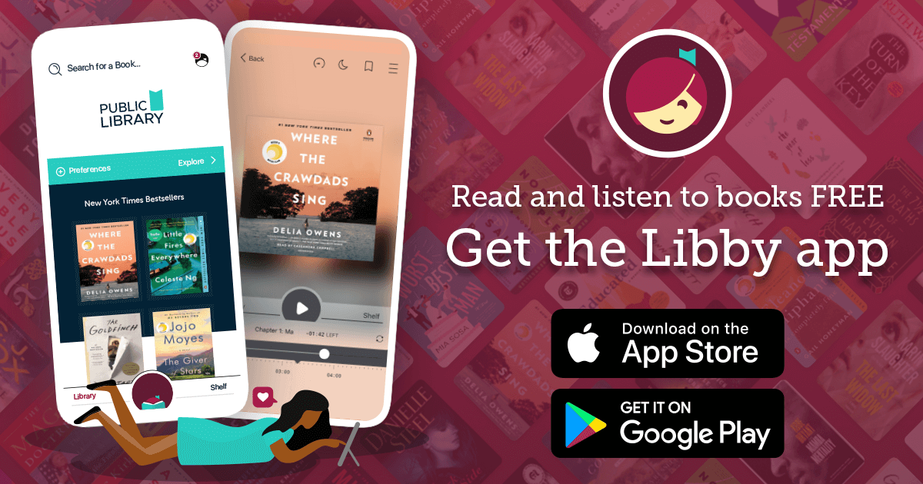
Ebooks + E-audio: Libby by Overdrive
Notes:
-If you haven’t downloaded the Libby app yet (or it’s been a few years since you tried ebooks/e-audio at the Library) you MUST TRY IT!
-It’s free on any tablet or smartphone; you just need your library card, PIN and email address to make an account
-You’ll find a fantastic selection and all the bestsellers: dissuaded be a long holds list? Place a hold! We keep track of holds by WVML patrons and purchase more copies of in-demand titles
-Our Library Foundation generously provides funding for extra copies of popular books that are only accessible by WVML cardholders
-Libby books are available to download on Kobo (this functionality will be automatically built into your Kobo if you bought it within the last 2-3 years)
-Unfortunately, Amazon does not permit any Canadian libraries to loan ebooks on Kindle
-if you’re debating between buying a new Kindle or Kobo – choose a Kobo for the ebook access!
-we can talk you through setting up your account or finding the right titles for you/your child

Slide 9
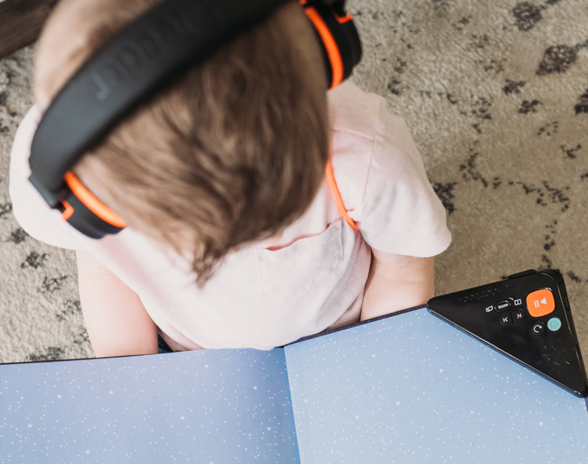
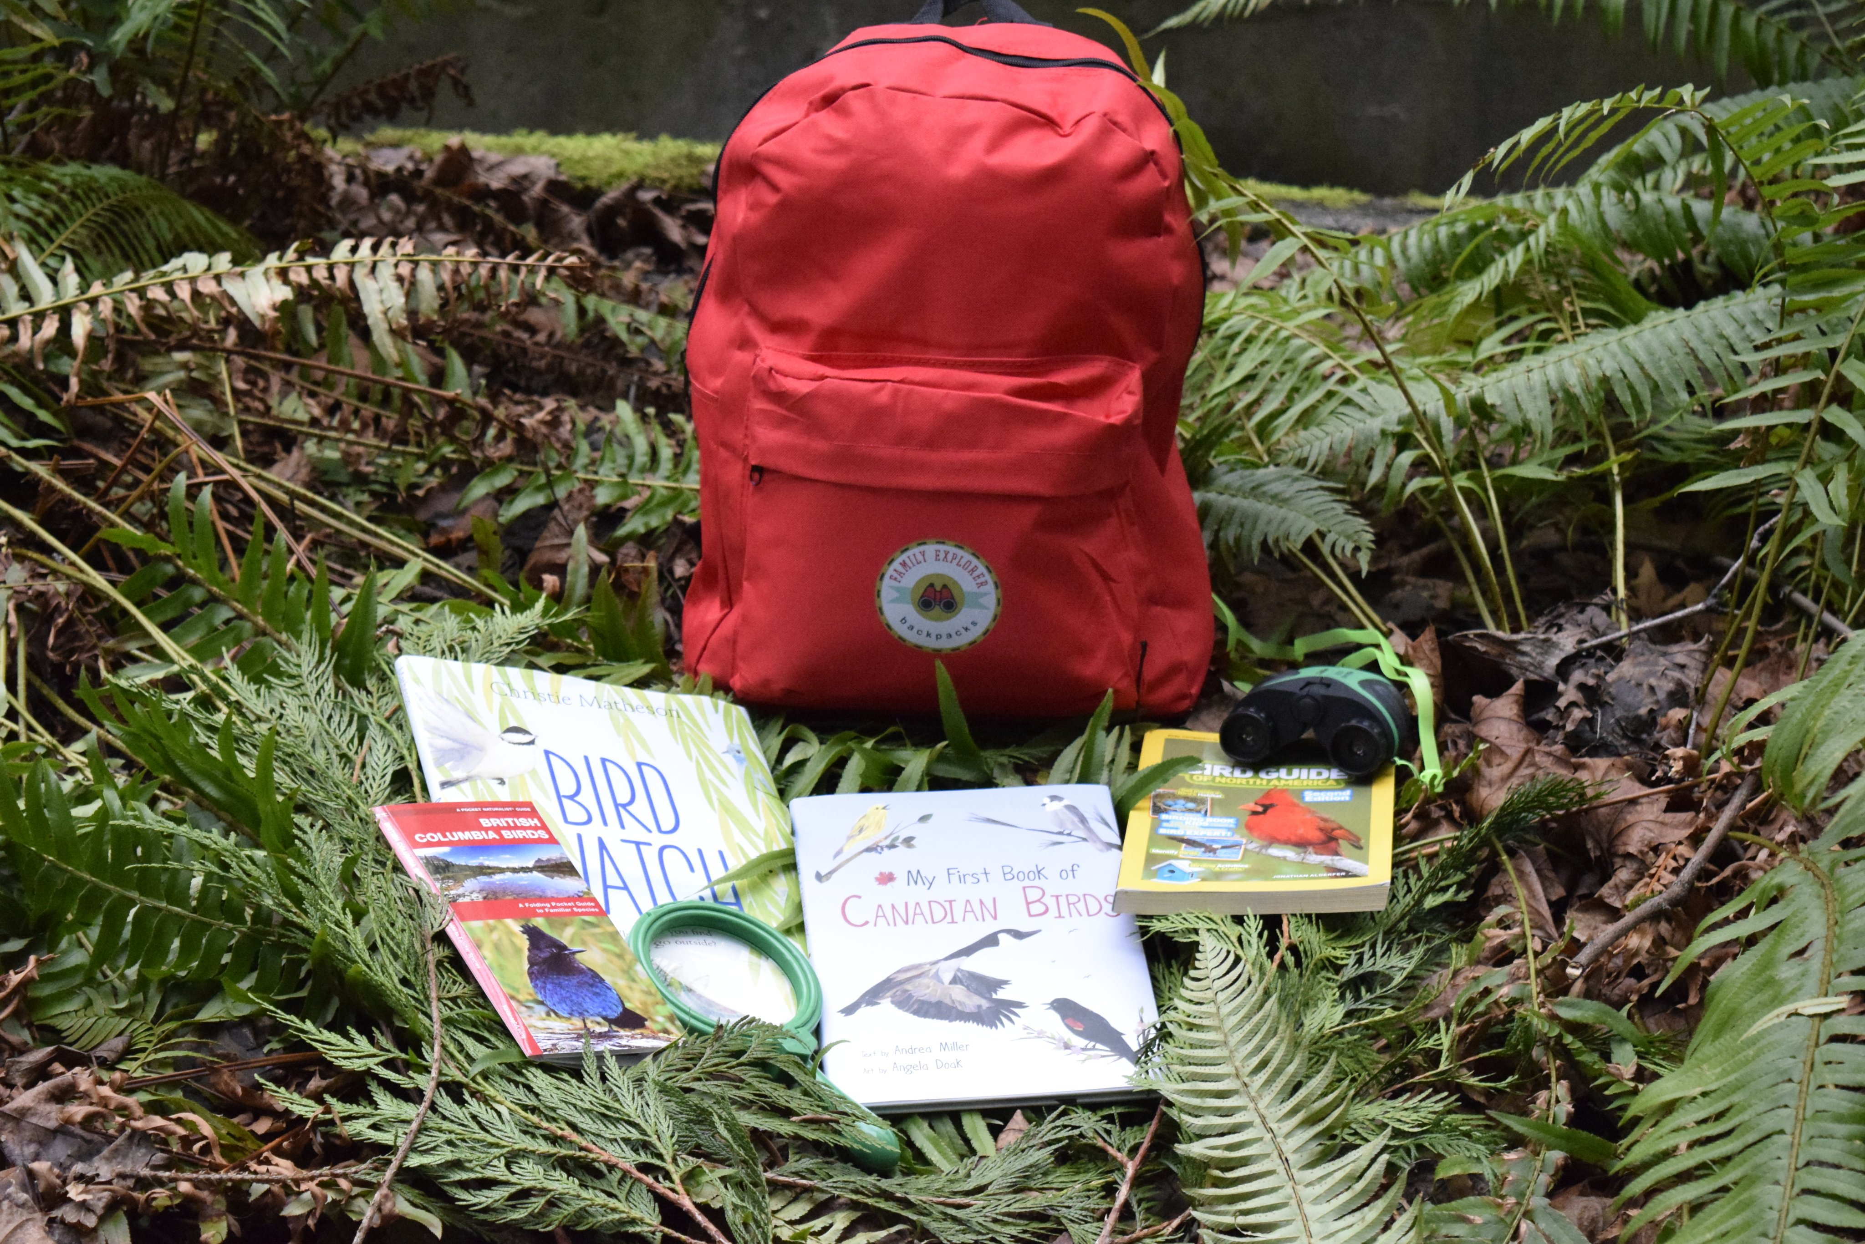
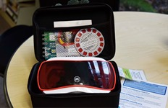
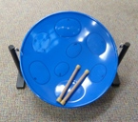
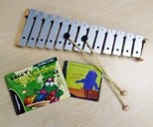
New Things to Borrow
Wonderbooks
Explorer Backpacks
Virtual Reality Starter Pack
Wee Musician Kits
Sphero Robot
Wee Musician Kits
Notes:
-Wonder Books: come with built in audiobook players so your child can hear the story being read while following along on the page (available in titles from picture books to upper elementary). Use your own headphones at home, charge if the power gets low.
-Explorer Backpacks: go on a close-to-home adventure and local flora, fauna and wildlife with tools like magnifying glasses, bug catchers and information on West Vancouver biology and animal science topics. For everyone but best for Kindergarten-Grade 4/5
-Technology Kits: borrow a Sphero Robot (requires your own iPad at home), Virtual Reality (requires your own smartphone at home) or Raspberry Pi Kit! Best for Grades 3+
-Wee Musicians bags: borrow a bag full or different percussion instruments, a glockenspiel, bongo drums or a steel drum! For everyone, best for Preschool-Grade 3
-We also have lots of new material in our Kids ELL section!

Slide 10
New Online Resource: Creativebug
Notes:
-you’d normally have to pay to access this treasure trove of hundreds of instructional arts and crafts videos (so much better than Youtube) but you can access for free with your Library card
-no ads!
-fantastic kids section with tons of STEAM activities

Slide 11
Need a PAC Speaker? We can present on:
Motivating striving and developing readers
English Language Learning resources for families
Best new releases on a certain topic or for a certain grade
The literacy benefits of comics, audiobooks + other formats
Introducing parents and upper elementary families to research databases
How families can save money and time with a library card
And much more! Just contact Shannon!

Slide 12
Find Your Child’s Next Great Read
Ask a librarian in-person or by email: youth@westvanlibrary.ca
Let your child choose their own books
Don’t count out non-fiction!
Don’t count out audiobooks!
Don’t count out comics!
Check out a book list:
(Almost) G-Rated Books for Kids Reading Above Grade Level
Short, Fast + Awesome for Middle Grade
Teen Books for Younger Readers
Kids Graphic and Hybrid Novels: Hidden Gems
See every Library book list for Kids, Teens and Adults on this page

Slide 13
Looking for custom recommendations?
Need Homework Help?
Want to Get Started with Libby?
Best way to get in touch with us: youth@westvanlibrary.ca
Call 604.925.7408
Sign up for the Library e-newsletter
Get in touch directly with Shannon (PAC Speaking Request): sozirny@westvanlibrary.ca, 604.925.7422

