Slide 1
Superintendent’s Report
December 2, 2020
Chris Kennedy, Superintendent of Schools

Slide 2
Summary of Topics
Enrolment 2020-21 and 2021-22
  A look at this year
  Early look at next year
Indigenous Program Update
  More self-identified Indigenous students than ever before (119)
  Enhancement Agreement
  Upcoming Board Presentation
Various Qs
  Hot lunch program
  How is TTP funded?
  Secondary and elementary sports
  Band vs. choir
  Filters, School Closures, Masks
Patience and Kindness

Slide 3
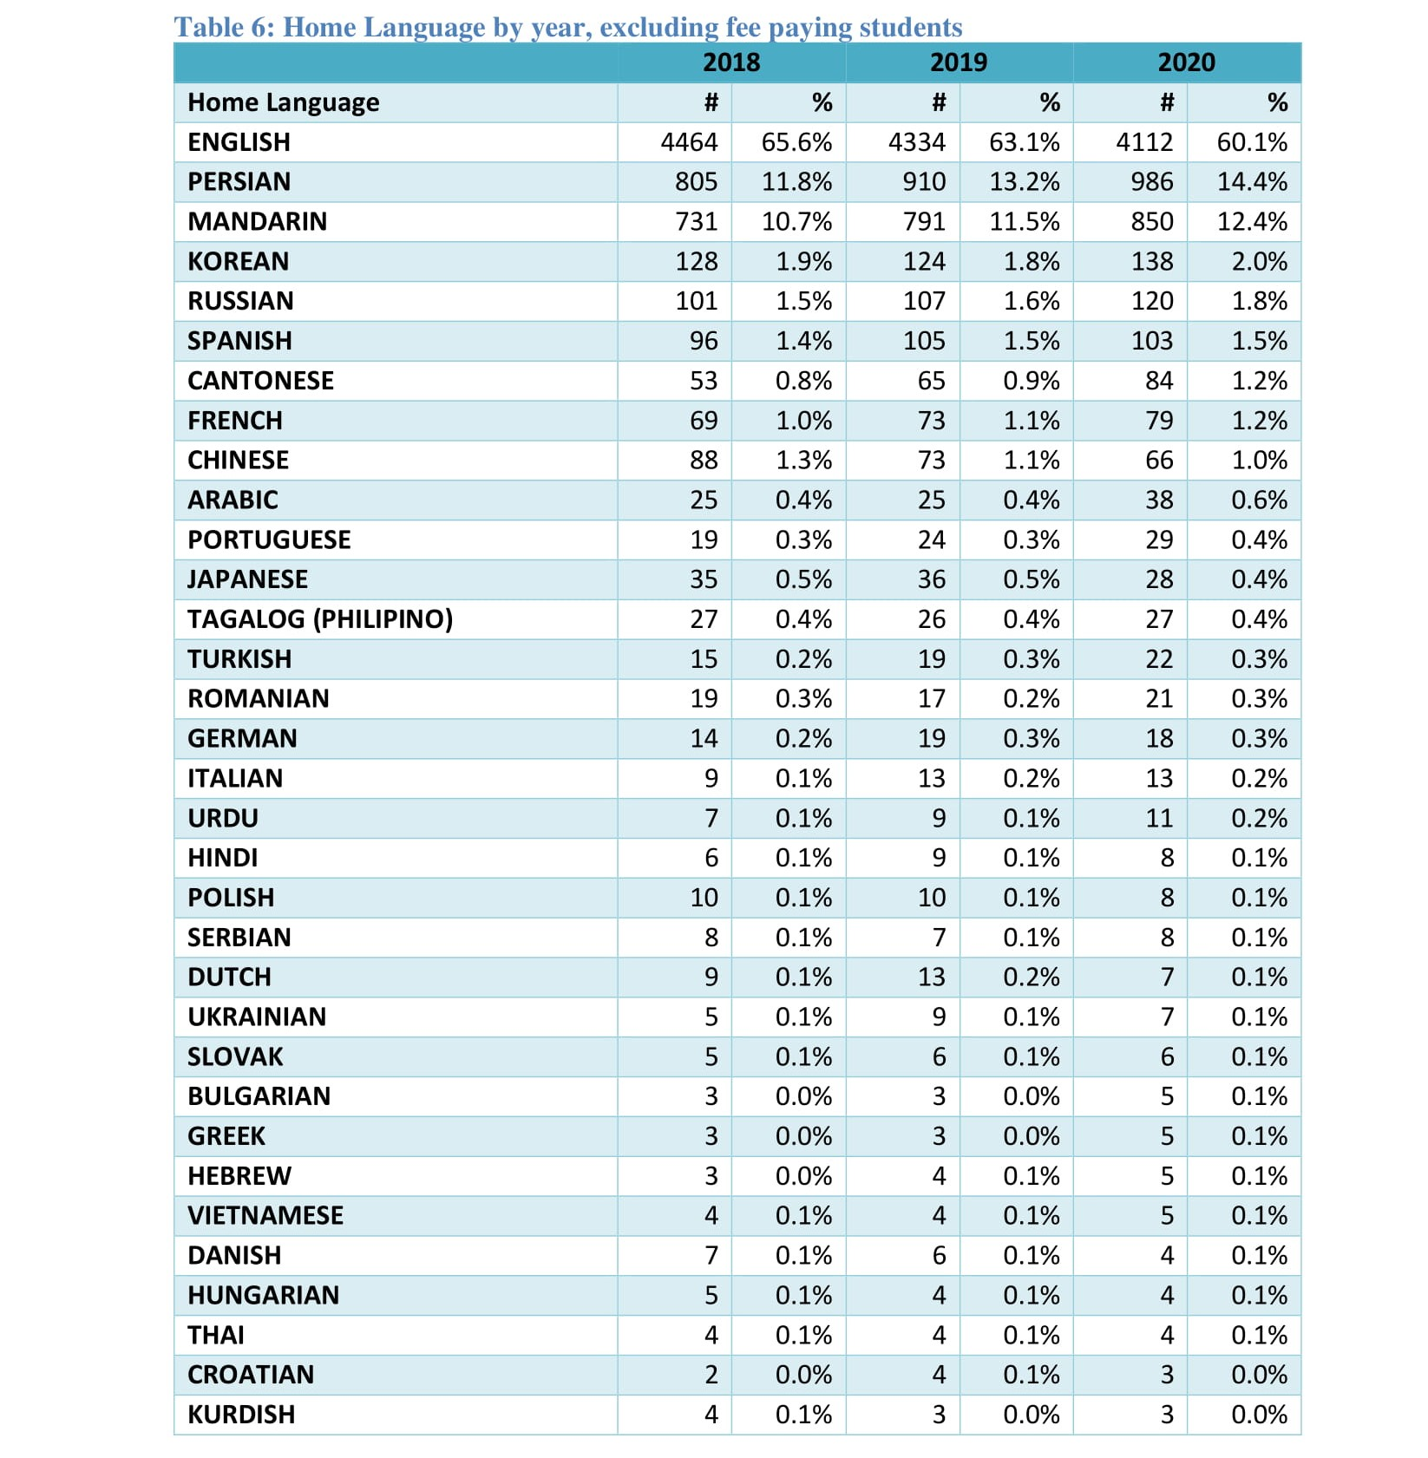

Slide 4
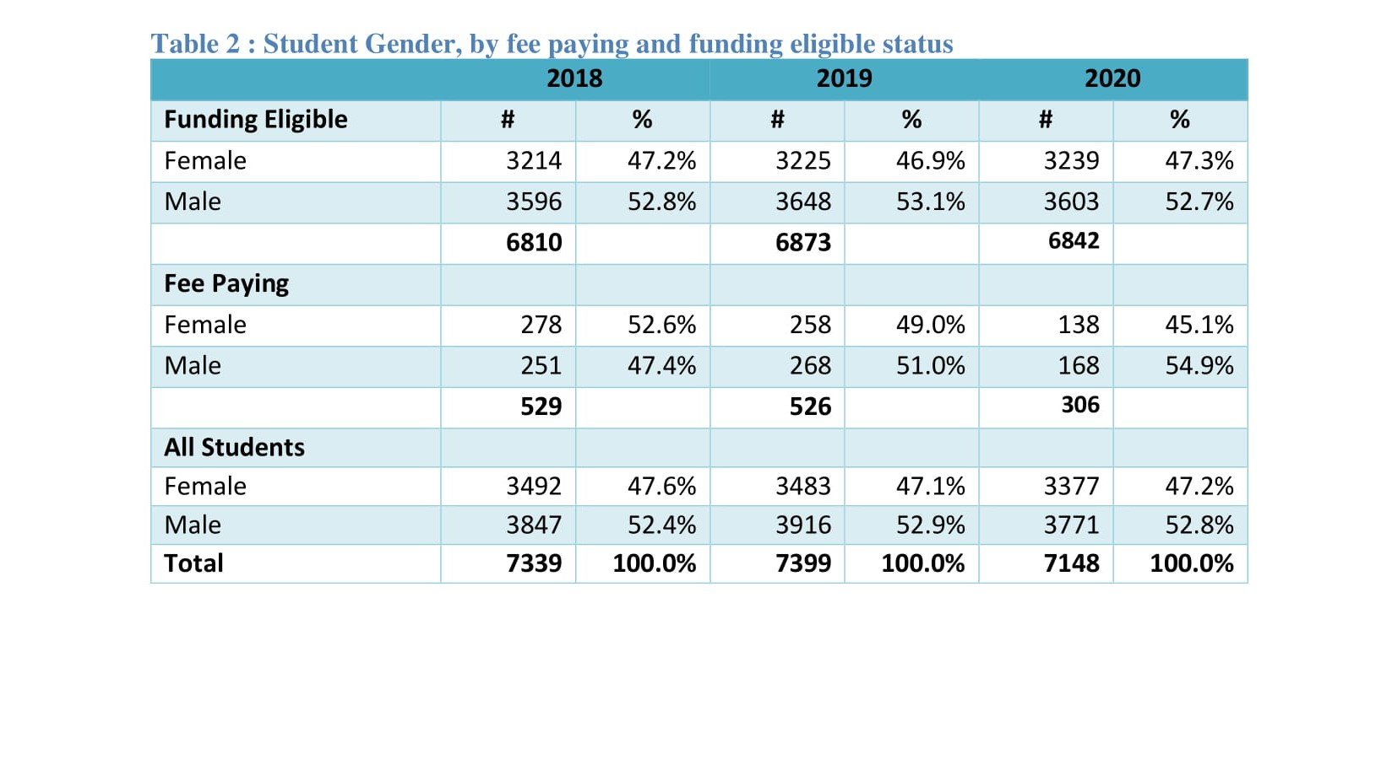

Slide 5
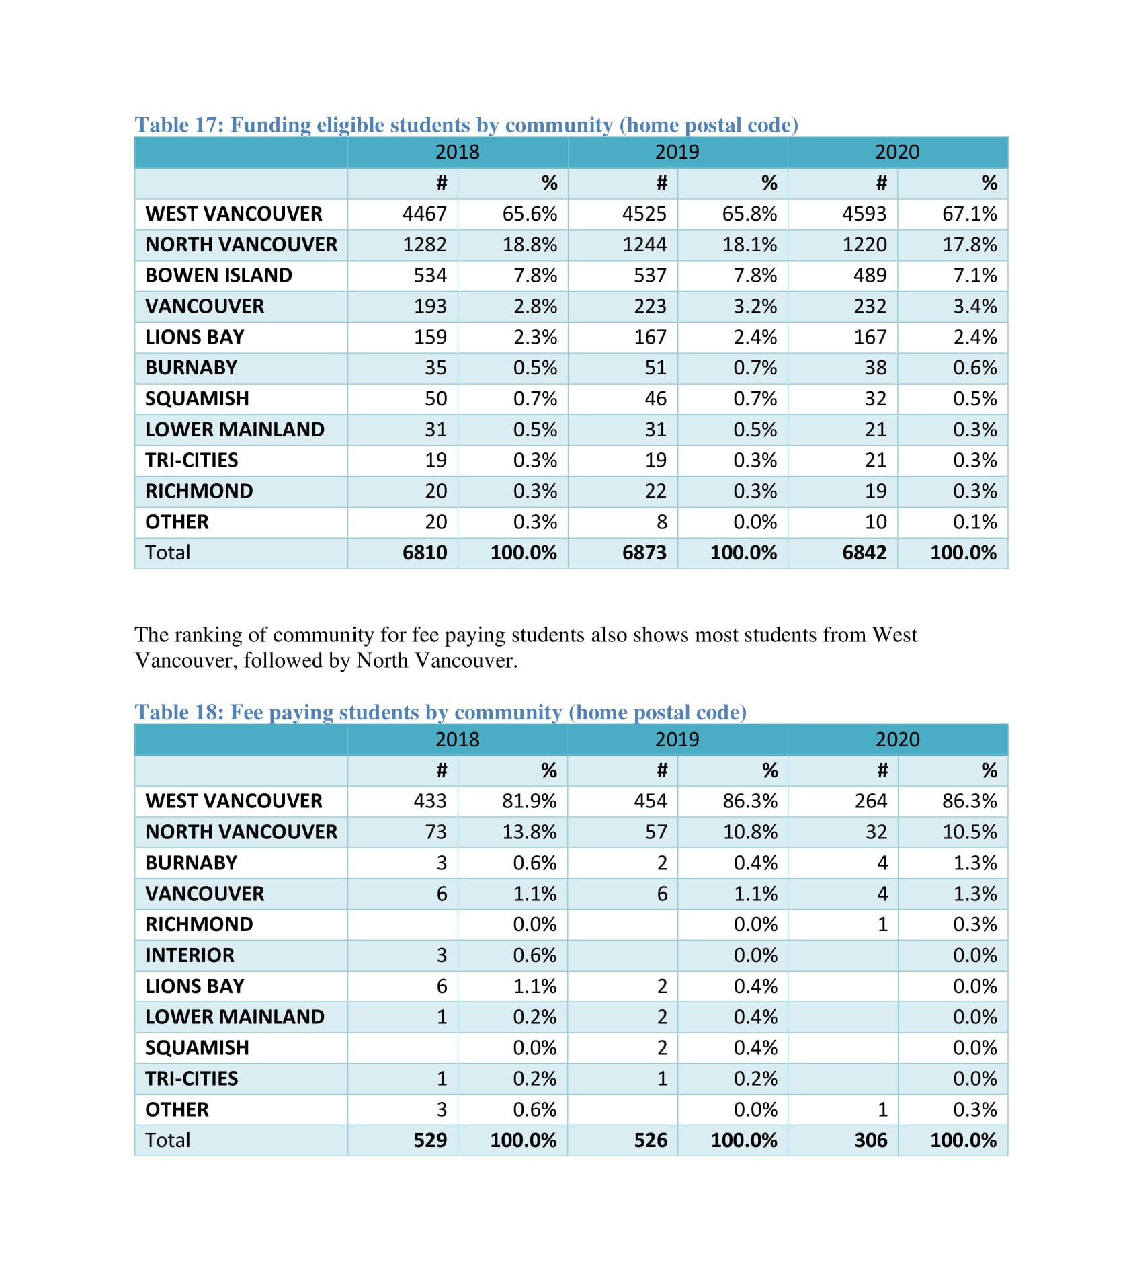

Slide 6
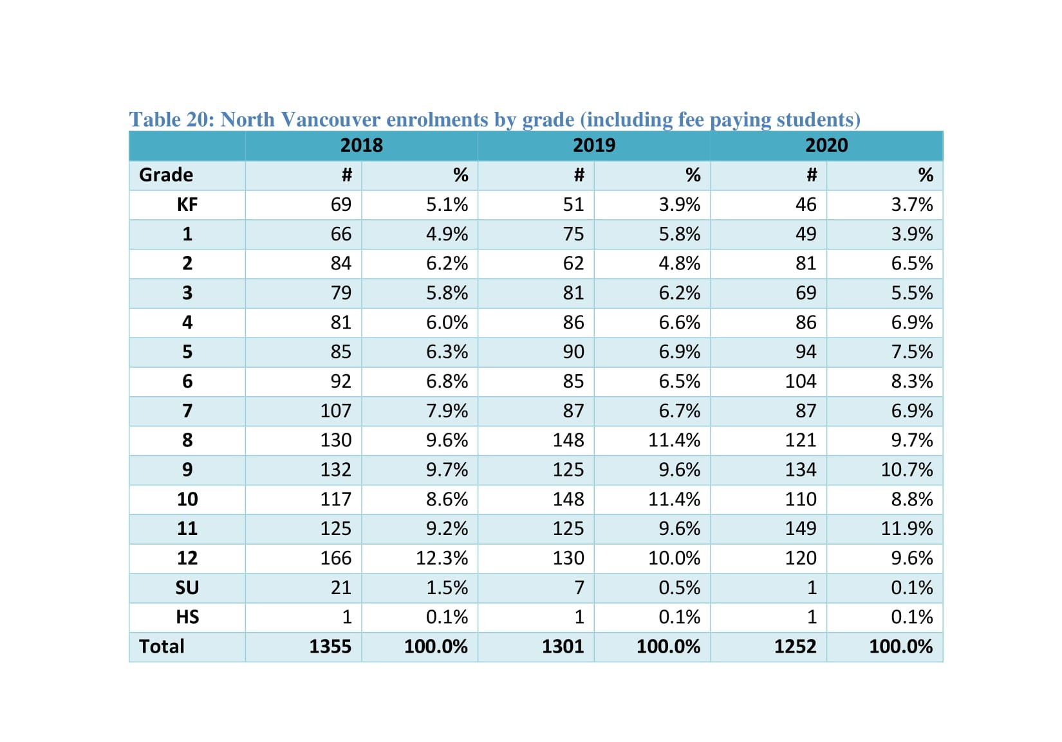

Slide 7
Current Applications 2020-21 vs. 2021-22
SCHOOL | 2021-2022 | 2020-2021
BICS | 9 | 2
Caulfeild | 21 | 17
Cedardale | 90 | 87
Chartwell | 8 | 8
Cypress Park | 6 | 15
Eagle Harbour | 5 | 4
Gleneagles | 18 | 6
Hollyburn | 14 | 8
Irwin Park | 40 | 24
Lions Bay | 6 | 0
Pauline Johnson | 47 | 42
Ridgeview | 17 | 14
West Bay | 78 | 43
Westcot | 49 | 33
Rockridge | 12 | 7
Sentinel | 8 | 4
WVSS | 9 | 9

Slide 8
Summary of Topics
Enrolment 2020-21 and 2021-22
  A look at this year
  Early look at next year
Indigenous Program Update
  More self-identified Indigenous students than ever before
  Enhancement Agreement
  Upcoming Board Presentation
Various Qs
  Hot lunch program
  How is TTP funded?
  Secondary and elementary sports
  Band vs. choir
  Filters, School Closures, Masks
Patience and Kindness

Slide 9
